Slide 1
KEYWORD SEARCHING SYSTEM
Made by:
ANUSHTUP GANGULY(REG NO.:978)
SAYAN MANDAL(REG NO.:1004)

Slide 2
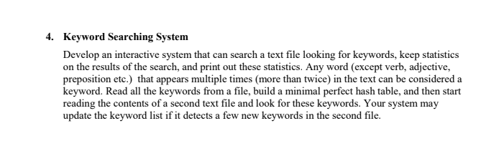
PROBLEM STATEMENT

Slide 3
HASHING ALGORITHM
ALGORITHM

Slide 4
INTRODUCTION TO HASHING
Hashing is a fundamental concept in computer science and information security that involves transforming data into a fixed-size numerical value or hash code. This process is commonly used for data storage, retrieval, and verification. The resulting hash code is typically a unique representation of the input data, and even a small change in the input can produce a significantly different hash code.
The primary purpose of hashing is to provide a quick and efficient way to identify and retrieve data from large collections. Instead of searching through all the data elements, a hash function is used to compute a hash code based on the data's contents. The hash code acts as a sort of digital fingerprint for the data, allowing for rapid lookup and comparison.

Slide 5
How to determine if a problem can be solved by hashing?
Unique Identification: Does the problem require unique identification or lookup of data elements? If the problem involves identifying or retrieving data based on a unique key, hashing can be a suitable solution. Hashing allows for quick access to data based on its hash code, enabling efficient lookup operations.
Efficiency: Is the problem concerned with efficient data storage and retrieval? Hashing excels in scenarios where fast access to data is essential. Hash tables, for example, provide constant-time average case lookup, insertion, and deletion operations, making them efficient for many applications.
Data Integrity: Does the problem involve ensuring data integrity or detecting changes in data? Hashing can be employed for data integrity checks by comparing hash codes before and after data transmission or storage. If the hash codes match, the data is likely unchanged, providing a simple and reliable integrity check.
Duplicate Detection: Is the problem focused on detecting and managing duplicates? Hashing can be useful for identifying duplicate data elements. By hashing each element and storing it in a hash table, duplicates can be detected efficiently.
Password Management: Does the problem involve password storage or authentication? Hashing is commonly used for secure password storage. Instead of storing passwords directly, their hash codes are stored.

Slide 6
LIMITATIONS
1.Missing Memory Allocation for `KeywordTable` Structure:
The `KeywordTable` structure is not being allocated memory using `malloc` or similar function. To fix this, add the following line before using the `KeywordTable` variable:
KeywordTable* keywordTable = (KeywordTable*)malloc(sizeof(KeywordTable));
2. Potential Buffer Overflow:
In the `insertKeyword` function, the line `strcpy(keyword->word, word);` copies the given `word` into `keyword->word` without checking if it exceeds the maximum word length. To prevent buffer overflow, you can change it to:
strncpy(keyword->word, word, MAX_WORD_LENGTH - 1);
keyword->word[MAX_WORD_LENGTH - 1] = '\0';

Slide 7
3. Missing Check for Maximum Keyword Count:
In the `insertKeyword` function, there is no check for the maximum keyword count before inserting a new keyword. To fix this, add a condition to check if the keyword count exceeds the maximum, and if so, print an error message and return.
if (table->numKeywords >= MAX_KEYWORDS) {
printf("Keyword table is full. Cannot insert more keywords.\n");
return;
}
4. Incorrect Loop Termination Condition:
In the main function, the while loop that reads the keywords from the file should terminate when `fscanf` returns `EOF`, but it is currently checking for inequality (`!= EOF`). To fix this, change the condition to equality (`== EOF`):
while (fscanf(keywordFile, "%s", word) == 1) {
insertKeyword(keywordTable, word);
}
5. Memory Deallocation for `KeywordTable` Structure:
In the cleanup part of the `main` function, the memory allocated for the `keywordTable` variable using `malloc` is not being deallocated. Add the following line before the return statement:
free(keywordTable);

Slide 8
TEXT FILE:
//5 He has a red book cover. I think this book is worth reading. He spent the evening reading a book and then fell asleep. I read the book from cover to cover. I finally got hold of that book I wanted.
//4 I have eaten an apple this morning .Pretty double doors open onto a garden with an apple tree. The favourite dish with all ages was apple pie. These bad apple can thrive in a bad barrel.
//3 He has a white cat and a dog.The cat is a very adorable animal. The cat can be kept as pets in our houses as well.
//5 She has a black dog and a cat. The dog is a pet animal. The dog is a very useful and faithful animal. The dog are of different breeds, some are small, some dog have large hair on their body etc.
//5 The elephant is very big . The elephant has four legs. Dancing wheeled like an elephant on his bronco and clattered away through the mud.During an elephant hunt a number of natives set upon him and beat him brutally about the head.The elephant is not particularly sagacious in the wild state, but becomes so when tamed.

Slide 9
KEYWORD FILE:
book
apple
cat
dog
elephant

Slide 10
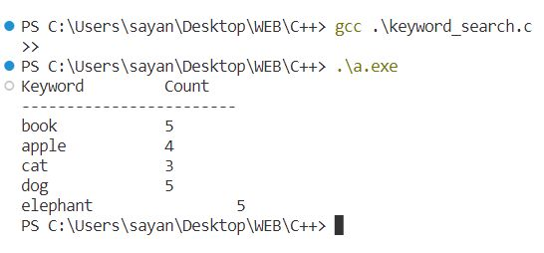
The Output will be as follows:

